Slide 2
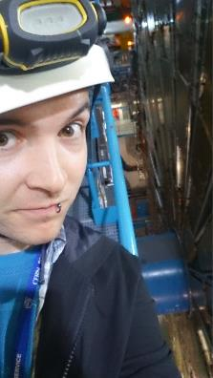
YOU could work at CERN!
Technician Training Experience
  Spend up to two years at CERN after completing your apprenticeship/HNC/HND
  Amazing international experience
  Lots of support and practical training
  Opportunities include engineering, radiation protection, photography and many other sectors
  No degree necessary
  Google ‘CERN Jobs’ for more info!
Jamie Pinnell, Technician Fellow, ATLAS experiment

Slide 3

YOU could work at CERN!
Technical student
  Spend a year in industry at CERN as part of your degree
  Real projects with support from experienced colleagues
  Opportunities for engineering (civil, mechanical, electrical), computing, languages, communications and business students
  More than work experience
  Google ‘CERN Jobs’ for more info!
Loren Wright, Lead Engineer,
Body Structure (Product Development), Aston Martin Lagonda Ltd
CERN Technical Student 2011-12

Slide 4
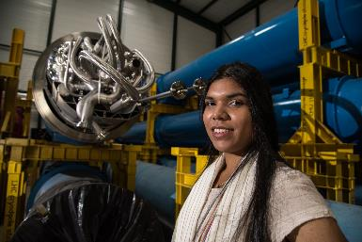
YOU could work at CERN!
Summer student
  Spend the penultimate summer of your undergraduate degree at CERN with 250+ students from around the world
  Top class lectures, inspiring visits, real projects and lifelong friendships
  Opportunities for physics, computing and engineering students
  Google ‘CERN Jobs’ for more info!
Jessica Flores, CERN Summer Student 2016

